Slide 1

Data Lake

Slide 2


Agenda
What is Data Lake
Why use Data Lake
Data Lake Architecture
Data Lake Vs Data Warehouse
2

Slide 3
Data Lake
What is Data Lake?
A data lake is a storage repository that holds a vast amount of raw data in its native format until it is needed for analytics applications. While a traditional data warehouse stores data in hierarchical dimensions and tables, a data lake uses a flat architecture to store data, primarily in files or object storage. That gives users more flexibility on data management, storage and usage.
Data lakes are often associated with Hadoop systems. In deployments based on the distributed processing framework, data is loaded into the Hadoop Distributed File System (HDFS) and resides on the different computer nodes in a Hadoop cluster. Increasingly, though, data lakes are being built on cloud object storage services instead of Hadoop. Some NoSQL databases are also used as data lake platforms.
3

Slide 4
Data Lake
Why use Data Lake?
Data lakes commonly store sets of big data that can include a combination of structured, unstructured and semistructured data. Such environments aren't a good fit for the relational databases that most data warehouses are built on. Relational systems require a rigid schema for data, which typically limits them to storing structured transaction data. Data lakes support various schemas and don't require any to be defined upfront. That enables them to handle different types of data in separate formats.
As a result, data lakes are a key data architecture component in many organizations. Companies primarily use them as a platform for big data analytics and other data science applications requiring large volumes of data and involving advanced analytics techniques, such as data mining, predictive modeling and machine learning.
A data lake provides a central location for data scientists and analysts to find, prepare and analyze relevant data. Without one, that process is more complicated. It's also harder for organizations to take full advantage of their data assets to help drive more informed business decisions and strategies.
3

Slide 5
Data Lake
Data Lake Architecture
Main architectural principles distinguish data lakes from conventional data repositories:
No data needs to be turned away. Everything collected from source systems can be loaded and retained in a data lake if desired.
Data can be stored in an untransformed or nearly untransformed state, as it was received from the source system.
That data is later transformed and fit into a schema as needed based on specific analytics requirements, an approach known as schema-on-read..
3

Slide 6
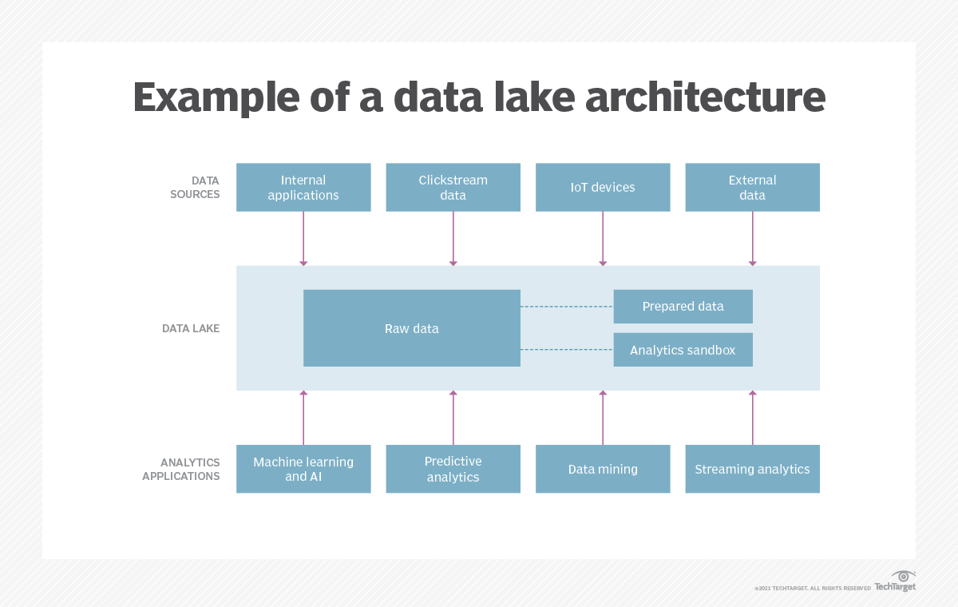
Data Lake
3

Slide 7
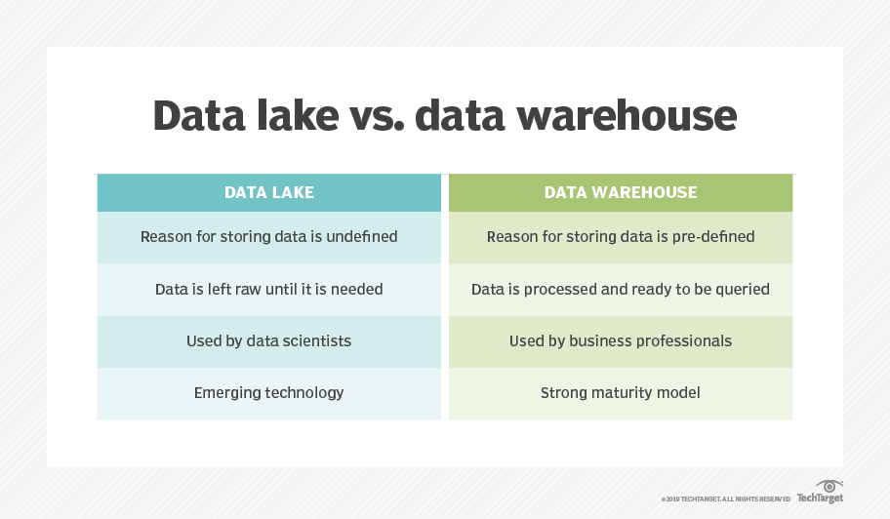
Data Lake
3

Slide 8
Data Lake
Data Lake Vs Data Warehouse
Main Difference: their support for data types and their approach to schema
Data warehouse: primarily stores structured data, the schema for data sets is predetermined, and there's a plan for processing, transforming and using the data when it's loaded into the warehouse.
Data lake: can house different types of data and doesn't need to have a defined schema for them or a specific plan for how the data will be used.
3

Slide 9
Data Lake
Data Lake Vs Data Warehouse
Other Differences:
Technology platforms
Data warehouse: includes a relational database running on a conventional server.
Data lake: is typically deployed in a Hadoop cluster or other big data environment.
Data sources
Data warehouse: is primarily extracted from internal transaction processing applications to support basic business intelligence (BI) and reporting queries, which are often run in associated data marts created for specific departments and business units.
Data lake: typically store a combination of data from business applications and other internal and external sources, such as websites, IoT devices, social media and mobile apps.
3

Slide 10
Data Lake
Data Lake Vs Data Warehouse
Other Differences:
Users
Data warehouse: are useful for analyzing curated data from operational systems through queries written by a BI team or business analysts and other self-service BI users.
Data lake: are better suited for use by data scientists who have the skills to sort through the data and extract meaning from it
Data quality
Data warehouse: is generally trusted as a single source of truth because it has been consolidated, preprocessed and cleansed to find and fix errors.
Data lake: typically store a combination of data from business applications and other internal and external sources, such as websites, IoT devices, social media and mobile apps.
3

Slide 11
Data Lake
Data Lake Vs Data Warehouse
Other Differences:
Agility and scalability
Data warehouse: less flexible because of their rigid schema and prepared data sets
Data lake: are highly agile platforms because they use commodity hardware, most can be reconfigured and expanded as needed to meet changing data requirements and business needs.
Security
Data warehouse: have more mature security protections because they have existed for longer and are usually based on mainstream technologies that likewise have been around for decades
Data lake: are improving, and various security frameworks and tools are now available for big data environments.
3

